Slide 1
Part 2: Building an NDT for Next-Generation WLANs with traditional AI/ML/DL
Paola Soto and Miguel Camelo

Slide 2
Introduction to AI/ML/DL techniques

Slide 3
What is Machine Learning?
Branch of Artificial Intelligence.
Can be used to solve problems.
The models are not explicitly programed.
Machines learn without human intervention.
But it needs human guidance.
Heuristics
Data
Machine
Output
Model
Machine Learning
Data
Machine
Model
Output
Notes:
When you have a problem, you can solve it by following s series of steps. These steps are normally what in computer science we call an algorithm or an heuristic.
But that means that in your mind, you have an internal model that tells you how to solve the problem. That knowledge that you have, you put it directly into a program or script. Then you have the output, that is the solution to your problem.
Depending on the type of problem, you can have a model
for example a formula that lets you know the future price of the electricity
Set of actions to go from point A to point B
But for other type of problems, it is very difficult to come up with a model.
A visual representation of shapes and their link with names → How do you model that a lion is a lion? How do you put it into a program?
Most of the time, human behavior cannot be modeled.
That is when ML comes into action.

Slide 4
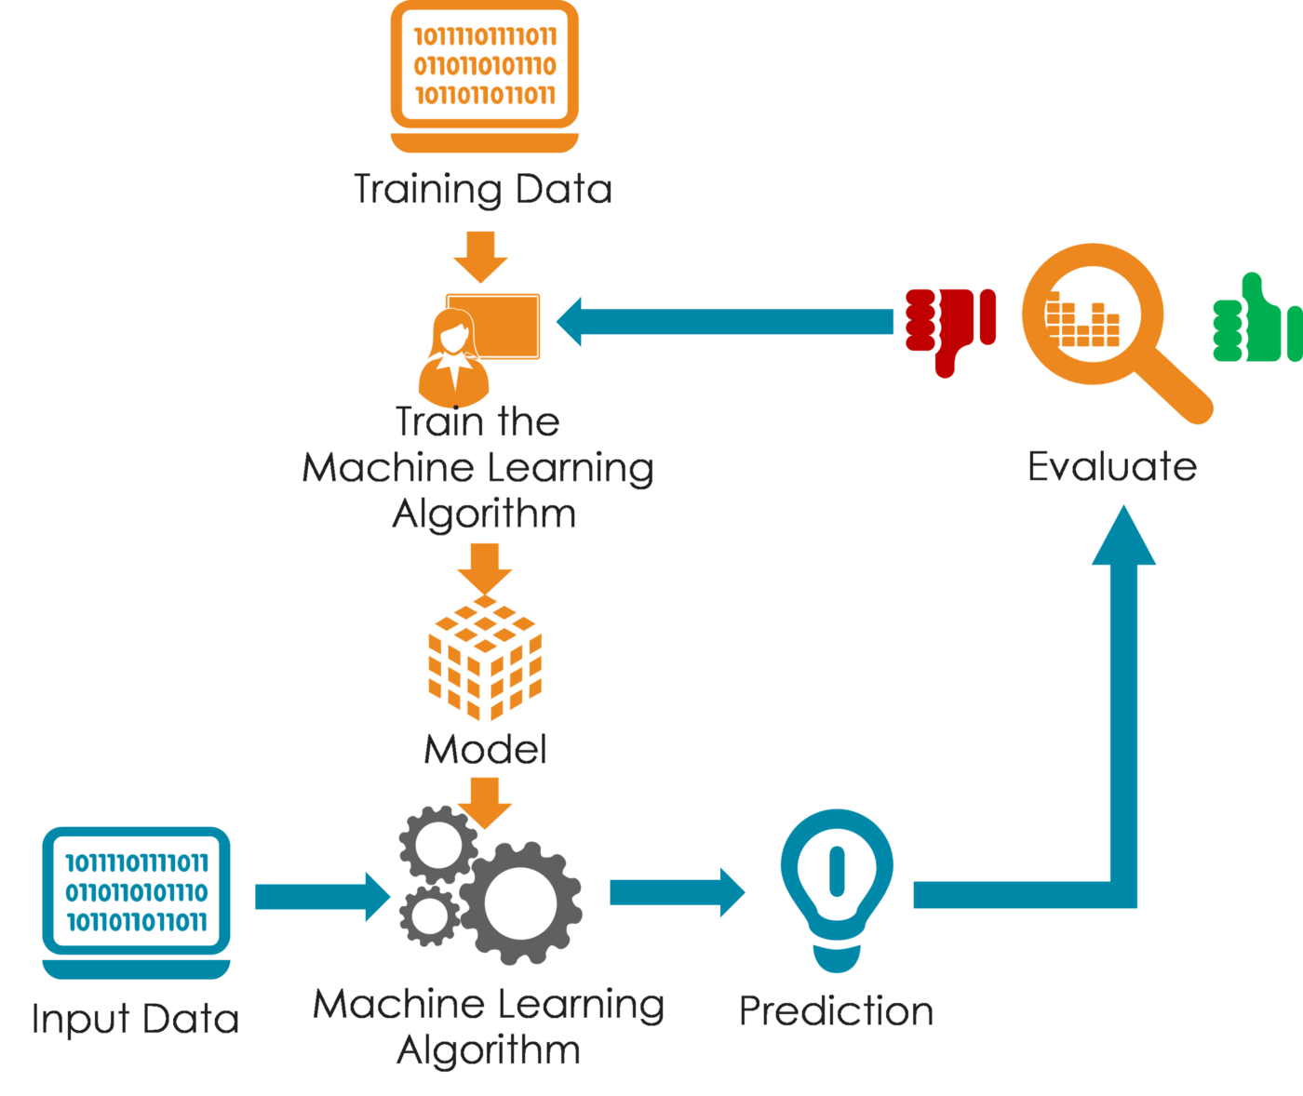
The Machine Learning cycle
Training
Train: Procedure to build a model.
Inference: Test your mode with (real/different) data.
Re-train.
Validation
Image taken from: https://bit.ly/3hLvKHD
Inference

Slide 5

Machine Learning Types
Image taken from: https://bit.ly/3sSL3EF

Slide 6
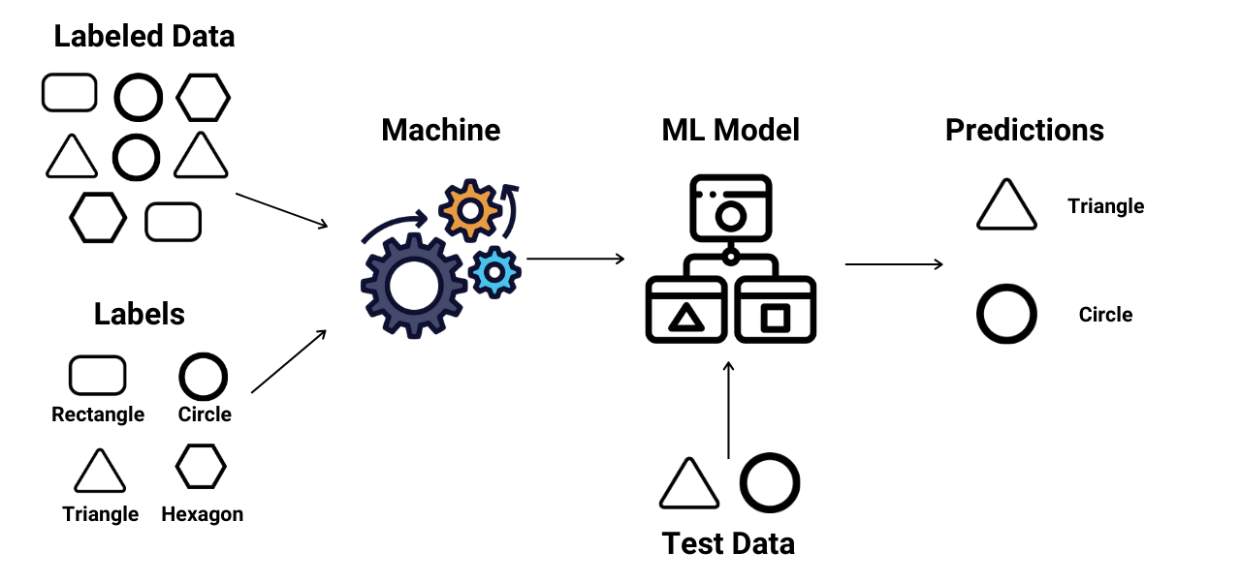
Supervised Learning
Image taken from: https://bit.ly/3sRlQKE

Slide 7
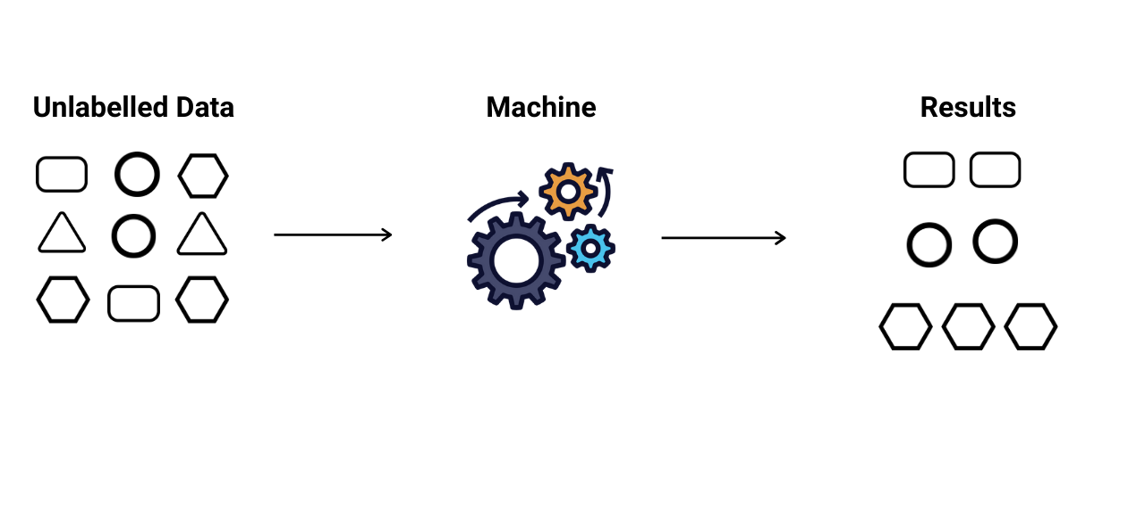
Unsupervised Learning
Image taken from: https://bit.ly/3HT5iGo

Slide 8
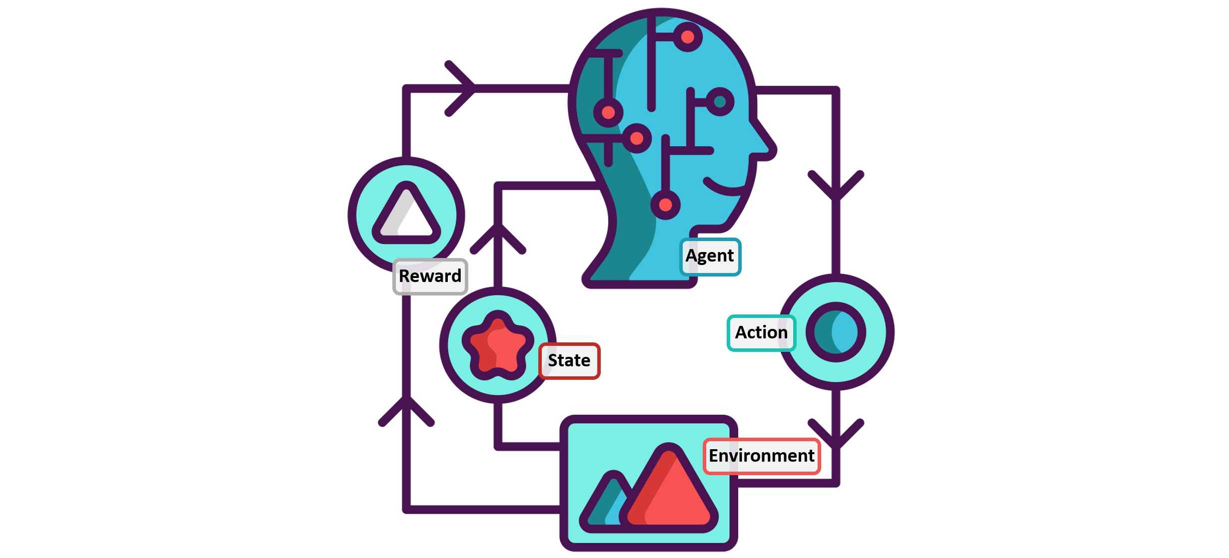
Reinforcement Learning
Image taken from: https://bit.ly/3tykdAE

Slide 9
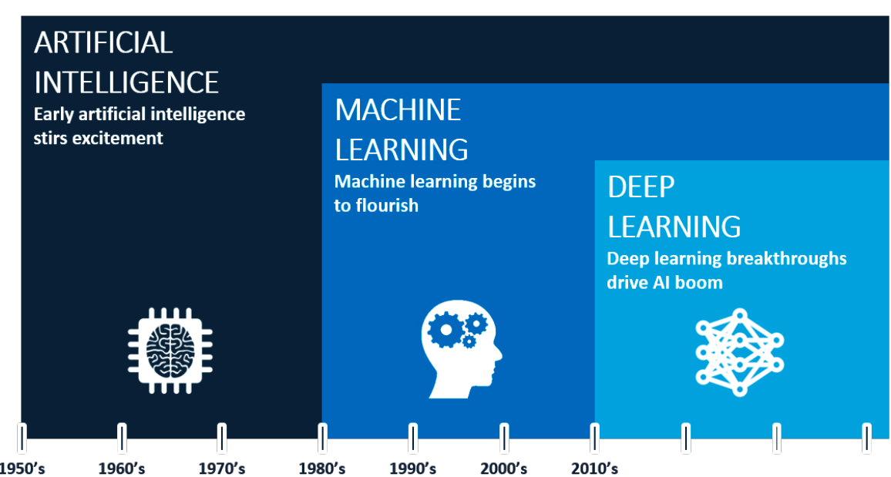
AI vs ML vs DL
Notes:
AI imitates intelligence. Inspired by nature.
ML learns from data
DL uses neural networks. Imitates brain functioning.

Slide 10
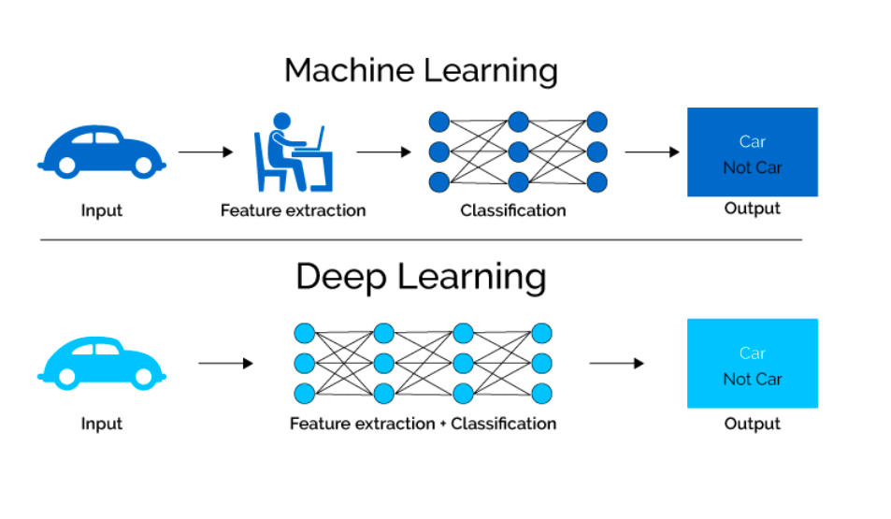
AI vs ML vs DL

Slide 11
AI vs ML vs DL
Learning problems
Optimization
Prediction
Classification
Regression
Optimization
Simulation
Machine Learning
Deep Learning
Artificial Intelligence
Deep Learning
Machine Learning

Slide 12
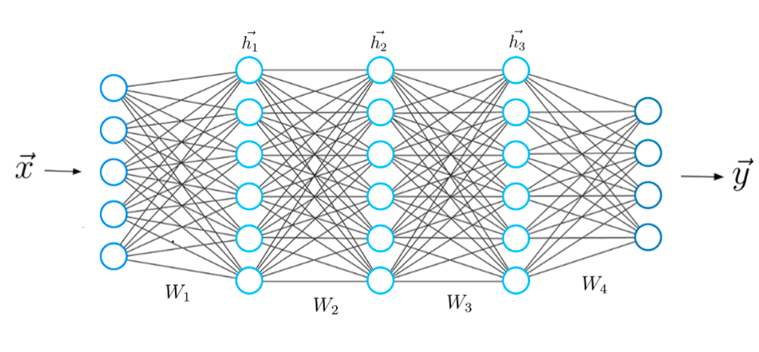
How the models learn?
Neural Networks
Notes:
This is a typical structure of a Neural Network.
The first layer is known as the input layer, the last layer is known as the output layer, and all the layer in between are known as the hidden layers.
Upfront you have to determine the size of all your layers.
The weigths represent how important is a given feature respect to the output.

Slide 13


Classification problems
Working with Images – MNIST dataset
Notes:
First, we vectorize the image.

Slide 14
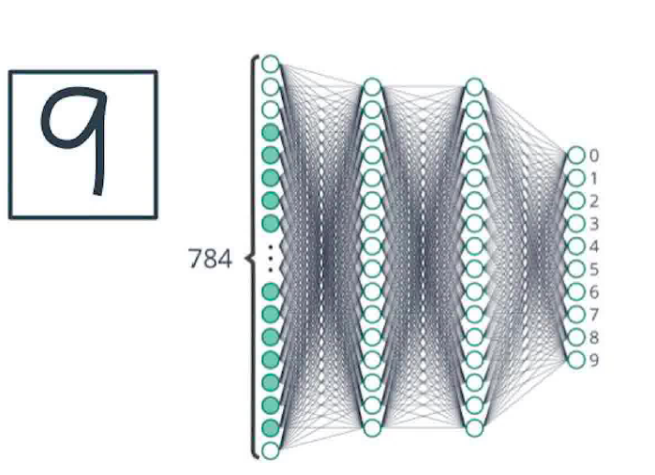
Classification problems
Working with Images – MNIST dataset
Output of the neural network
Notes:
First, we vectorize the image.
Then we select the size of the neural network.

Slide 15
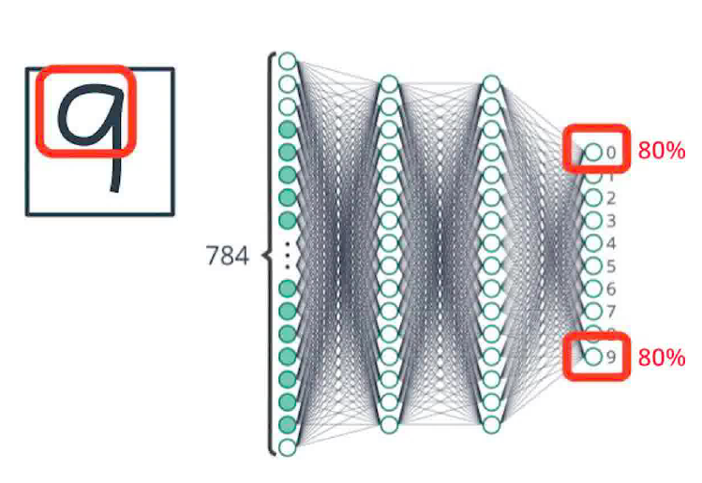
Classification problems
Working with Images – MNIST dataset
Notes:
First, we vectorize the image.
Then we select the size of the neural network.
Then we operate. The first layers are responsible of learning the most simple features.

Slide 16
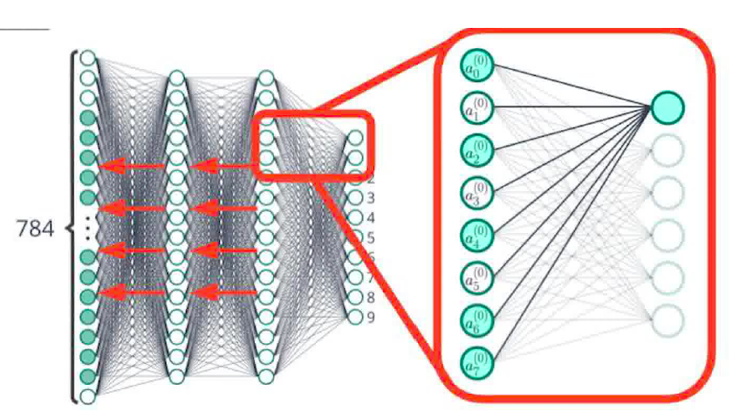
Classification problems
Working with Images – MNIST dataset
Backpropagation
Notes:
First, we vectorize the image.
Then we select the size of the neural network.
Then we operate. The first layers are responsible of learning the most simple features.
Finally, if there is some mistake, we correct them by adjusting the weights in a step called back propagation

Slide 17



Digital Twins
(1). Measurements
(e.g., network state)
(3). Expected performance
(4). Channel
Configurations
Controller
Network Model
(2). Set of configurations to evaluate
(1). Measurements
(e.g., network state)
Notes:
In previous slides we have seen that we can build a model of the reality using ML.
Then, this model we can use it as network digital twin. Several techniques can be used to build that network digital twin, but given their ability to learn from data, the most promising ones are based in AI and ML, so they can have a more accurate view of the reality.
Mathematical models are based on assumptions that might not hold in real deployments.
Markov models are too complex when the deployment size grows.

Slide 18
Introduction to Dataset

Slide 19
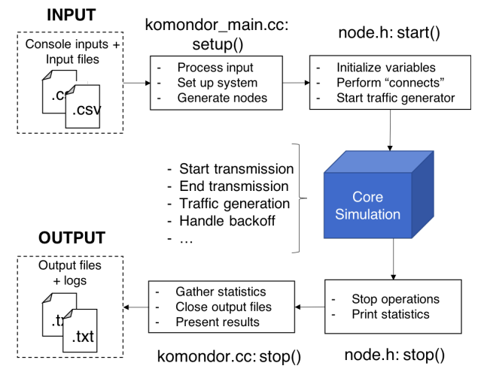

Dataset
Introduction
Generated through Komondor
A Wireless network simulator that includes novel mechanisms for next-generation WLANs, such as dynamic channel bonding or enhanced spatial reuse in dense scenarios.
Validated against ns-3²
input_node_sce{#}_deployment_{#}.csv
script_output_sce{#}.txt
2. Barrachina-Muñoz, S., Wilhelmi, F., Selinis, I., & Bellalta, B. (2019, April). Komondor: a wireless network simulator for next-generation high-density WLANs. In 2019 Wireless Days (WD) (pp. 1-8). IEEE.

Slide 20
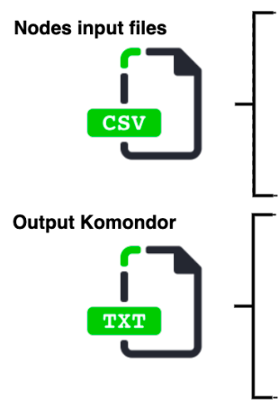
Dataset
Overview
Node ID
BSS ID
Node position
Channels selected
Transmission capabilities (tx power, sensitivity, etc.)
Other information (CW, traffic load, etc.)
Features
RSSI list (power that each STA receives from its AP)
Interference map (power sensed by each AP from other AP)
Airtime (percentage of time occupying the channel)
SINR ()
Throughput (effective transmission rate)
Label
Source: https://www.itu.int/en/ITU-T/AI/challenge/2020/Documents/ITU%20AI_ML%20Challenge%20-%20UPF.pdf

Slide 21
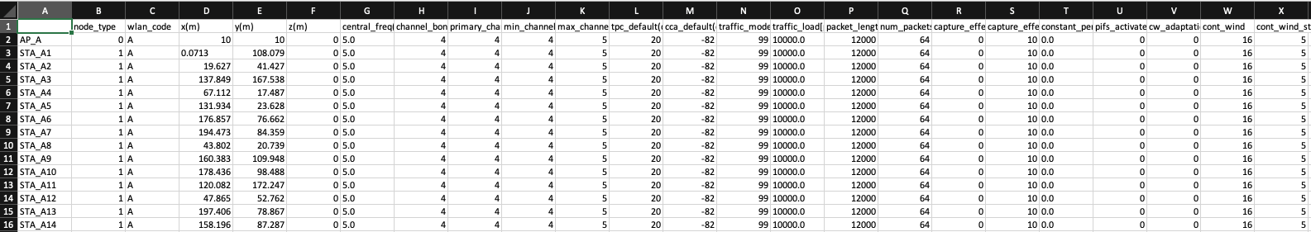
Dataset
Example input data

Slide 22
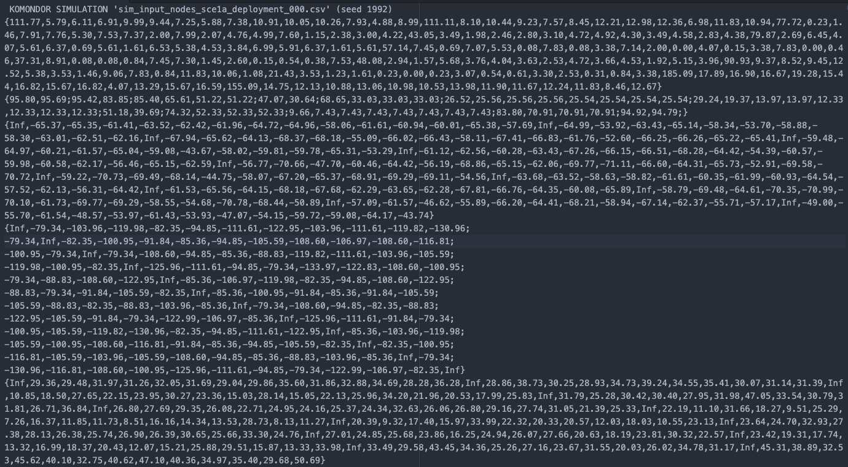
Dataset
Example output data
Scenario ID
Throughput per STA
Airtime
RSSI
Interference
Map
SINR

Slide 23
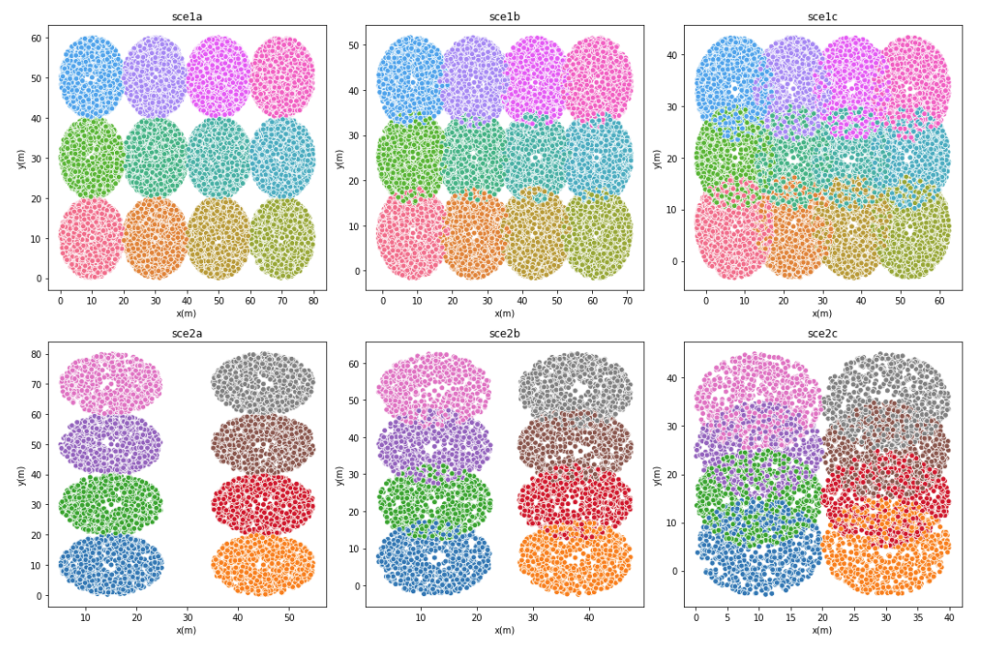
Training Dataset
Characteristics
Two scenarios with modifications on user density per m²
3 map sizes per scenario.
100 deployments per scenario.
Each scenario introduce more interference than the other.
Different channel configurations.
80% Training – 480 Graphs.
20% Validation – 120 Graphs.
Scenario 1: 12APs 10-20 STAs
Scenario 2: 8APs 5-10 STAs
40/30/20 m
60/50/40 m
60/50/40 m
80/70/60 m
Notes:
The training dataset is composed of two scenarios with different density of users per square meter and each of the scenarios introduce more interference among WLANs. So we can see scenarios like 1a and 2a where only inter station interference is present to scenarios like 1c and 2c where inter WLAN interference is also present. We used a typical 80%-20% split of training and validation data.

Slide 24
Test Dataset
Characteristics
Scenario 1: 4APs
60 m
Four testing scenarios.
Different spatial distribution than training.
50 random deployments per scenario.
Scenario 2: 6APs
60 m
Scenario 3: 8APs
60 m
Scenario 4: 10APs
60 m
80 m
Notes:
The test dataset shows a different spatial distribution and a different density of users as well. The idea is to observe if the proposed solution is able to generalize to unseen deployments.

Slide 25
Hands – On

Slide 26
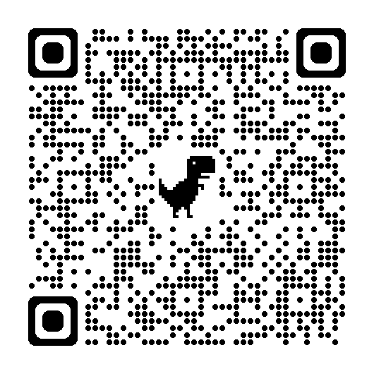
Link
Notebook: Building an NDT for next-generation WLANs using ML/DL

